Slide 1
Digital Systems
18B11EC213
Karnaugh Map

Slide 2
Contents
Algebraic Simplification
Karnaugh Map Simplification
2 variables K-Map
3 variables K-Map
4 variables K-Map
5 variables K-Map
Simplified SOP expression
Simplified POS expression

Slide 3
Function Simplification
Why simplify?
  Simpler expression uses less logic gates.
  Thus: cheaper, less power, faster (sometimes).
Simplification techniques:
  Algebraic Simplification.
    simplify symbolically using theorems/postulates.
    requires skill but extremely open-ended.
  Karnaugh Maps.
    diagrammatic technique using ‘Venn-like diagram’.
    easy for humans (pattern-matching skills).
    simplified standard forms.
    limited to not more than 6 variables.

Slide 4
Algebraic Simplification
Algebraic simplification aims to minimise
(i) number of literals, and
(ii) number of terms
But sometimes conflicting.
Difficulty – needs good algebraic manipulation skills.
Advantage – very open-ended (to your desired form!)

Slide 5
Algebraic Simplification
Example:
(x+y).(x+y').(x'+z) (6 literals)
= (x.x+x.y'+x.y+y.y').(x'+z) (assoc.)
= (x+x.(y'+y)+0).(x'+z) (idemp.,assoc., compl.)
= (x+x.(1)+0).(x'+z) (complement)
= (x+x+0).(x'+z) (identity 1)
= (x).(x'+z) (idemp, identity 0)
= (x.x'+x.z) (assoc.)
= (0+x.z) (complement)
= x.z (identity 0)
Number of literals reduced from 6 to 2.

Slide 6
Algebraic Simplification
Find minimal SOP and POS expressions of
f(x,y,z) = x'.y.(z + y'.x) + y'.z
x'.y.(z+y'.x) + y'.z
= x'.y.z + x'.y.y'.x + y'.z (distributivity)
= x'.y.z + 0 + y'.z (complement, null element 0)
= x'.y.z + y'.z =z(x’ y+y’)=z(y+y’)(x’+y’) (identity 0) = x'.z + y’.z (absorption)
= (x' + y').z (distributivity)
Minimal SOP of f = x'.z + y'.z (2 2-input AND gates and
1 2-input OR gate)
Minimal POS of f = (x' + y').z (1 2-input OR gate and
1 2-input AND gate)
X+yz=(x+y)(x+z)

Slide 7
Algebraic Simplification
Find minimal SOP expression of
f(a,b,c,d) = a.b.c + a.b.d + a'.b.c' + c.d + b.d'
a.b.c + a.b.d + a'.b.c' + c.d + b.d'
= a.b.c + a.b + a'.b.c' + c.d + b.d' (absorption)
= a.b.c + a.b + b.c' + c.d + b.d' (absorption)
= a.b + b.c' + c.d + b.d' (absorption)
= a.b + c.d + b.(c' + d') (distributivity)
= a.b + c.d + b.(c.d)' (DeMorgan)
= a.b + c.d + b (absorption)
= b + c.d (absorption)
Number of literals reduced form 13 to 3.

Slide 8
Introduction to K-maps
Systematic method to obtain simplified sum-of-products (SOPs) Boolean expressions.
Objective: Fewest possible terms/literals.
Advantage: Easy with visual aid.
Disadvantage: Limited to 5 or 6 variables.
Karnaugh-map (K-map) is organised as a matrix of squares, where
  each square represents a minterm
  adjacent squares always differ by just one literal (so that the unifying theorem may apply: a + a' = 1)
To simplify any function using K-map, the function should be first converted to sum of minterms or product of maxterms.

Slide 9
2-variables K-maps
Alternative layouts of a 2-variable (a, b) K-map
Alternative 1:
Alternative 2:
b
b
a
a
OR
OR
a'b'
a'b
m0
m1
a'b'
ab'
m0
m2
a
ab'
ab
a
m2
m3
b
a'b
ab
b
m1
m3
Alternative 3:
a
OR
a
b
ab
a'b
b
m3
m1
and others…
ab'
a'b'
m2
m0

Slide 10
2-variables K-maps
Equivalent labeling:
b
b
0 1
a
equivalent to:
0
1
a
a
a
0 1
b
equivalent to:
0
1
b

Slide 11
2-variables K-maps
The K-map for a function is specified by putting
  a ‘1’ in the square corresponding to a minterm
  a ‘0’ otherwise
For example: Carry and Sum of a half adder.
b
b
0
0
0
1
a
0
1
a
1
0
C = ab
S = ab' + a'b

Slide 12
3-variables K-maps
There are 8 minterms for 3 variables (a, b, c). Therefore, there are 8 cells in a 3-variable K-map.
b
b
bc
bc
a
00 01 11 10
a
00 01 11 10
0
1
a'b'c'
a'b'c
a'bc
a'bc'
0
1
m0
m1
m3
m2
OR
a
ab'c'
ab'c
abc
abc'
a
m4
m5
m7
m6
c
c
Above arrangement ensures that minterms of adjacent cells differ by only ONE literal. (Other arrangements which satisfy this criterion may also be used.)
Note Gray code sequence

Slide 13
3-variables K-maps
There is wrap-around in the K-map:
  a'.b'.c' (m0) is adjacent to a'.b.c' (m2)
  a.b'.c' (m4) is adjacent to a.b.c' (m6)
bc
a
00 01 11 10
0
1
m0
m1
m3
m2
m4
m5
m7
m6
Each cell in a 3-variable K-map has 3 adjacent neighbours. In general, each cell in an n-variable K-map has n adjacent neighbours. For example, m0 has 3 adjacent neighbours: m1, m2 and m4.

Slide 14
4-variables K-maps
There are 2 wrap-arounds: a horizontal wrap-around and a vertical wrap-around.
Every cell thus has 4 neighbours. For example, the cell corresponding to minterm m0 has neighbours m1, m2, m4 and m8.
yz
y
wx
m0
m1
m3
m2
m4
m5
m7
m6
x
m12
m13
m15
m14
w
m8
m9
m11
m10
z

Slide 15
5-variables K-maps
Maps of more than 4 variables are more difficult to use because the geometry (hyper-cube configurations) for combining adjacent squares becomes more involved.
For 5 variables, e.g. vwxyz, need 2⁵ = 32 squares.

Slide 16
5-variables K-maps
Organised as two 4-variable K-maps: (vwxyz) (10001)
v '
v
y
y
yz
yz
wx
00 01 11 10
wx
00 01 11 10
00
01
11
10
m0
m1
m3
m2
00
01
11
10
m16
m17
m19
m18
m4
m5
m7
m6
m20
m21
m23
m22
x
x
m12
m13
m15
m14
m28
m29
m31
m30
w
w
m8
m9
m11
m10
m24
m25
m27
m26
z
z
Corresponding squares of each map are adjacent.
Can visualise this as being one 4-variable map on TOP of the other 4-variable map.

Slide 17
Simplification Using K-maps
Based on the Unifying Theorem:
A + A' = 1
In a K-map, each cell containing a ‘1’ corresponds to a minterm of a given function F.
Each group of adjacent cells containing ‘1’ (group must have size in powers of twos: 1, 2, 4, 8, …) then corresponds to a simpler product term of F.
  Grouping 2 adjacent squares eliminates 1 variable, grouping 4 squares eliminates 2 variables, grouping 8 squares eliminates 3 variables, and so on. In general, grouping 2^{n} squares eliminates n variables.

Slide 18
Simplification Using K-maps
Group as many squares as possible.
  The larger the group is, the fewer the number of literals in the resulting product term.
Select as few groups as possible to cover all the squares (minterms) of the function.
  The fewer the groups, the fewer the number of product terms in the minimized function.

Slide 19
Simplification Using K-maps
Example:
F (w,x,y,z) = w’.x.y'.z' + w'.x.y'.z + w.x'.y.z'
+ w.x'.y.z + w.x.y.z' + w.x.y.z
= Σ m(4, 5, 10, 11, 14, 15)
y
yz
wx
00 01 11 10
00
01
11
10
1
1
(cells with ‘0’ are not
shown for clarity)
x
1
1
w
1
1
z

Slide 20
Simplification Using K-maps
Each group of adjacent minterms (group size in powers of twos) corresponds to a possible product term of the given function.
y
yz
wx
00 01 11 10
00
01
11
10
A
1
1
x
1
1
w
1
1
B
z

Slide 21
Simplification Using K-maps
There are 2 groups of minterms: A and B, where:
A = w'.x.y'
B = w.y
Each product term of a group, w'.x.y' and w.y, represents the sum of minterms in that group.
y
F(w,x,y,z) = A + B = w'.x.y' + w.y
yz
wx
00 01 11 10
00
01
11
10
A
1
1
x
1
1
w
B
1
1
z

Slide 22
Simplification Using K-maps
Other possible valid groupings of a 4-variable K-map include:
1
1
1
1
1
1
1
1
1
1
1
1
1
1
1
1
1
1
1
1




Slide 23
Simplification Using K-maps
Groups of minterms must be
(1) rectangular/square, and
(2) have size in powers of 2’s.
Otherwise they are invalid groups. Some examples of invalid groups:
1
1
1
1
1
1
1
1
1
1
1
1
1
1
1
1



Slide 24
Prime Implicant
A prime implicant is a product term obtained by combining the maximum possible number of minterms from adjacent squares in the map.
Use bigger groupings (prime implicants) where possible.
1
1
1
1
1
1
1
1
1

1
1
1


Slide 25
Essential Prime Implicant
No redundant groups:
An essential prime implicant is a prime implicant that includes at least one minterm that is not covered by any other prime implicant.
1
1
1
1
Redundant prime implicant


1
1
1
1
1
1
1
1
1
1
1
1
Essential prime implicants

Slide 26
Quick Review Question
Identify the prime implicants and the essential prime implicants in the following K maps.
b
A
bc
AB
a
00 01 11 10
CD
00 01 11 10
00
01
11
10
1
1
1
0
1
1
1
0
1
1
1
a
0
1
0
0
D
1
1
1
C
c
1
1
1
B

Slide 27
Simplest SOP Expressions
Algorithm 1(non optimal):
  1. Circle all prime implicants on the K-map.
  2. Identify and select all essential prime implicants for the cover.
  3. Select a minimum subset of the remaining prime implicants to complete the cover, that is, to cover those minterms not covered by the essential prime implicants.

Slide 28
Simplest SOP Expressions
Example:
f(A,B,C,D) = ∑ m(2,3,4,5,7,8,10,13,15)
A
AB
CD
00 01 11 10
00
01
11
10
1
1
All prime implicants
1
1
D
1
1
1
C
1
1
B

Slide 29
Simplest SOP Expressions
A
A
AB
AB
00 01 11 10
CD
00 01 11 10
CD
Essential prime implicants
00
01
11
10
1
1
00
01
11
10
1
1
1
1
D
1
1
1
1
1
D
C
1
1
1
1
1
C
B
1
1
B
A
AB
CD
00 01 11 10
00
01
11
10
1
1
Minimum cover
1
1
D
1
1
1
C
1
1
B

Slide 30
Simplest SOP Expressions
A
AB
A'BC'
CD
00 01 11 10
00
01
11
10
1
1
AB'D'
1
1
D
1
1
1
C
1
1
BD
B
A'B'C
F(A,B,C,D) = B.D + A'.B'.C + A.B'.D' + A'.B.C'

Slide 31
Quick Review Question
Find the simplified expression for G(A,B,C,D).
A
AB
CD
00 01 11 10
00
01
11
10
1
1
1
1
D
1
1
1
C
1
B

Slide 32
Getting POS Expressions
Simplified POS expression can be obtained by grouping the maxterms (i.e. 0s) of given function.
Example:
Given F=∑m(0,1,2,3,5,7,8,9,10,11), we first draw the K-map, then group the maxterms together:
A
AB
CD
00 01 11 10
00
01
11
10
1
0
0
1
1
1
0
1
D
1
1
0
1
C
1
0
0
1
B

Slide 33
Getting POS Expressions
A
AB
CD
00 01 11 10
00
01
11
10
1
0
0
1
K-map of F
1
1
0
1
D
1
1
0
1
C
1
0
0
1
B
To get POS of F, we have:
F = (B'+D).(A'+B’)

Slide 34
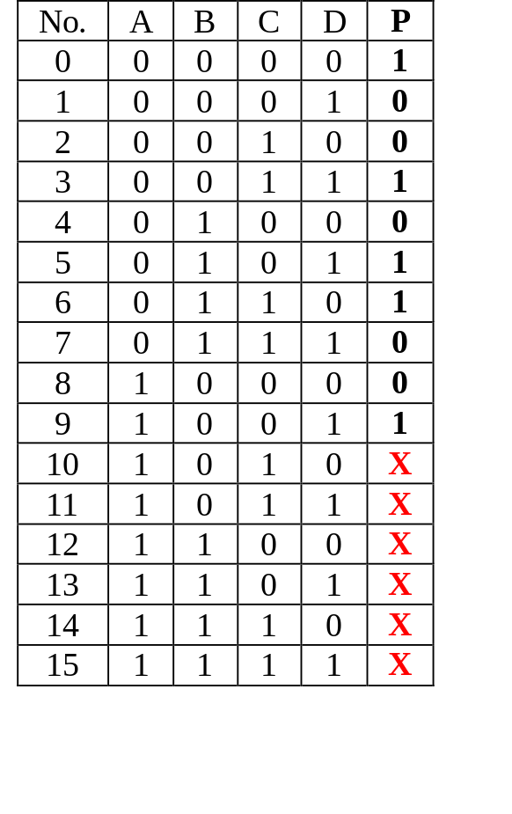
Don’t-care Conditions
In certain problems, some outputs are not specified.
These outputs can be either ‘1’ or ‘0’.
They are called don’t-care conditions, denoted by X (or sometimes, d).
Example: An odd parity generator for BCD code which has 6 unused combinations.

Slide 35
Don’t-care Conditions
C
CD
For comparison:
  WITHOUT Don’t-cares:
P = A'.B'.C'.D’ + A'.B'.C.D + A'.B.C'.D
+ A'.B.C.D' + A.B'.C'.D
  WITH Don’t-cares:
P = A'.B'.C'.D' + B'.C.D + B.C'.D
+ B.C.D' + A.D
AB
00 01 11 10
00
01
11
10
1
1
1
1
B
A
1
D
C
CD
AB
00 01 11 10
00
01
11
10
1
1
1
1
B
X
X
X
X
A
1
X
X
D

Slide 36
Examples
F(A,B,C,D) = A.B.C + B'.C.D' + A.D + B'.C'.D'
First convert it into sum of minterms which gives:
F(A,B,C,D) = ∑m(0, 2, 8, 9, 10, 11, 13, 14, 15)
A
AB
CD
00 01 11 10
00
01
11
10
1
1
Find all PIs:
A.D
A.C
B'.D'
1
1
D
1
1
C
1
1
1
B
Are all ‘1’s covered by the PIs? Yes, so the answer is: F(A,B,C,D) = A.D + A.C + B'.D'

Slide 37
Examples
Example # (with don’t cares):
F(A,B,C,D) = ∑ m(2,8,10,15) + ∑ d(0,1,3,7)
A
AB
Do we need to have an additional term A'.B' to cover the 2 remaining x’s?
No, because all the 1’s (minterms) have been covered.
CD
00 01 11 10
00
01
11
10
X
1
X
D
X
X
1
C
1
1
B
F(A,B,C,D) = B'.D' + B.C.D

Slide 38
Examples
Find simplest POS:
F(A,B,C,D) = A.B.C + B'.C.D' + A.D + B'.C'.D’
F(A,B,C,D) = ∑m(0, 2, 8, 9, 10, 11, 13, 14, 15)
Or F(A,B,C,D) = ΠM(1, 3, 4, 5, 6, 7, 12)
AB
CD
00 01 11 10
00
01
11
10
0
0
From K-map,
F = (A+B').(A+D').(B'+C+D)
0
0
0
0
0

Slide 39
Examples
Find simplest POS expression for:
F(A,B,C,D) = ∑ m(2,8,10,15) + ∑ d(0,1,3,7)
Or F(A,B,C,D) = ΠM(4,5,6,9,11,12,13,14)+Πd(0,1,3,7)
A
AB
CD
00 01 11 10
00
01
11
10
X
0
0
F = (B'+C).(B'+D).(B+D')
X
0
0
0
D
X
X
0
C
0
0
B

Slide 40
References
A. Anand Kumar, “Fundamentals of Digital Circuits”, PHI, Fourth Edition.
S. Salivahanan and S. Arivazhagan, “Digital circuits and design”, Vikas Publishing House PVT Limited, Fifth edition.

